Slide 1
Bryan Mackenzie
User Experience Design
User Experience Design ≠ User Interface Design

Slide 2
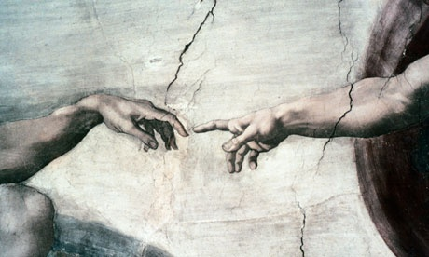
User Experience Design: Agenda
Feedback Case Study
Forgiveness
Consistency and expectation
Reliability Case Study
Usability
Notes:
In this presentation we’ll be looking at a experience design with a focus on gestures. We’ll cover a few examples and look at the different aspects to consider when developing and application that uses gestures.
Specifically we’ll look at A Feedback Case Study, developing with user action Forgiveness in mind. Considerations for keeping Consistency and user expectation, and developing reliable gestures that are user friendly. Let’s jump right in to the case study on feedback. Click

Slide 3
User Experience Design
Feedback
It is important that there always be a connection between actions and results.
When a gestures is recognized, is there visual indication of an action on behalf of the users command?
If a video is clicked, it should play. If a button is selected, it should animate and initiate an action.
*Ask yourself: Does the feedback mechanism make sense? Does it detract from the action or task?
Feedback mechanism One
Feedback Mechanism Two
Case Study: Crafting a good user experience
Notes:
Here we are going to take a look at some work we did with the RealSense Web Navigation.
During development we went through several User testing phases and learned quite a bit about design.
We saw first hand that the feedback mechanism was the quickest way to make or break an experience.
What I hope to convey here is that designing with feedback in mind for the best experience is rather simple and starts with a few simply questions:
Is it responsive?
Does the feedback make sense?
Does the feedback detract from the experience?
We’ll start by looking at the application after the first round of user testing, once we incorporated the results from our users.
Click Video Link
Now let’s take a look at the result after we really thought about the content, the context and the feedback model.
Click Demo Link
Feedback Model Two: In the final version we went with a dynamic approach to show the user real-time feedback on actions without detracting from the task, in this case content navigation and interaction. The idea behind this experience is that the user will spend most of there time cooking, not staring at the page, so we wanted to make interaction fast, and easy to the point where the user can focus on cooking and getting to the content they want with nominal effort.
Again, the important questions to ask about feedback:
Is it responsive?
Does it make sense?
Does it detract from the experience?

Slide 4
User Experience Design
Forgiveness
Understanding the limitations of tracking, we can better design with forgiveness in mind to create better experiences.
Video Link
*Ask yourself: Can the end-user easily make mistaken? How easily can one recover from a mistake?
Does the design require finer granular or course movements for interaction?
Could it be done better with another form of input?
Does the gesture map to multiple actions?
How easily can the user make a mistake?
A few things to consider in your gesture integration
Notes:
Forgiveness
Understanding the limitations of tracking, we can better design with forgiveness in mind to create better experiences. But what is Forgiveness in terms of interaction: Forgiveness is a well established principal, take the mouse click as an example, if buttons are close and in clusters there is a increased chance of clicking on an undesired button option
In the case of clicking, we solve this by giving a generous click zone…for gestures, think about the design and how to avoid false positives and unintended outcomes.
A few things to consider with regards to user forgiveness:
Does the design require course or finer granularity for interaction?
If there are large buttons, why use 22 joints when a single blob extremity point will suffice.
Could it be done better with another form of input?
Perhaps certain joint combinations or a singular blob extremity could be used to rotate an object.
Does the gesture correlate to another action?
When a gesture is perform there is a resulting action, if the gesture results in an alternative action the user might think they did one thing but "really" did something else, they lose their sense of controlling the system because they don't understand the connection between actions and results.
How easily can the user make a mistake?
People tend to touch their face an average of 4 times an hours, be mindful of these actions like reaching for a cup or any action not intended as an interaction with the application. During UX testing we saw that the application interpreted an action when is was an intentional interaction.
Let’s look at an example of some early work on the RealSense browser interaction.
First iteration: Too many false positive results, not visual feedback to the user. Let’s take a
Look at a video where the may become an issue. This approach was prone to Initiate a swipe when it was not the intent of the user (Video)

Slide 5
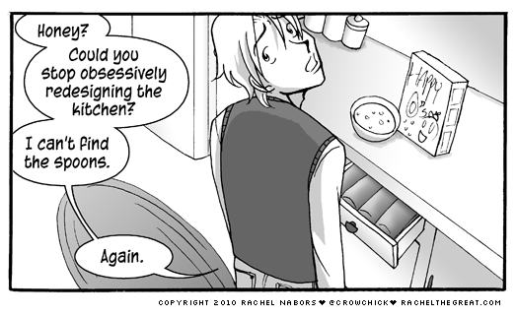
User Experience Design
Consistency and User Expectation
Why not come up with a radical new design?
Notes:
Consistency…Consistency makes it easier for end-users to adopt and learn new tools, but why is that so important? It is important because humans are great at pattern recognition. When there is deviation from a familiar pattern, it requires reevaluation, which requires Cognitive Energy Waste …where additional (unnecessary) time is spent thinking about how to interact as opposed to complete the task at hand. This is coupled with expectation.
Click
As illustrated above, user become comfortable and expect certain things to remain largely the same.
Navigation and consistency. I was recently asked by a large web developer about a standard for web based navigation using gestures. The concern is that with each developer a new navigation model will be introduced. Leaving users to relearn simple tasks such as a page scroll….does this make sense…no. This is a call to action, as it stands there are no standards for gestural interaction. Until that day we must make sure that we provide a consistent experience cross applications. This goal for users to open an application and know what to expect.

Slide 6

User Experience Design
Reliability
To provide a reliable experience we must implement and integrate gestures that compensate for failure.
*Ask yourself: Is my design bulletproof?
Drag over 30 Frames
Consecutive checks to
determine if pinch has
in fact been lost
Pinch lost due to speed
Notes:
To provide a reliable experience we must implement and integrate gestures that compensate for failure.
*Ask yourself: Is my design bulletproof? Probably Not, if you’ve done everything possible to mitigate error your on the right track. Understanding the limitations, helps design better functional interaction.
Click
In it’s current state gestures have a bad reputation for being unreliable…how do we fix this? Here one example of design with failure in mind for reliability.
Take for example pinch and drag loss vs speed. When designing a pinch and drag, fast movements are lost. We do not want the user to experience this...So how do we hide the lose and provide a reliable experience? Moreover, the users intended action must result in the expected outcome, if not a sense of control is lost.

Slide 7
User Experience Design
Usability
How “intuitive” or “natural’ are the gestures to perform?
Do they make sense within the current context?
Example: For Food network we implemented two methods for scrolling “hold and hover” and “Zone triggered variable speed hovering”
show a video of the two in actions
What makes hold and hover less “natural” and the weaker of the two options?
Holding and hovering with a delay means there is a delayed response to the actions.
Hold a static pose is far less comfortable than completing a simple movement and gaining the response. There is the added benefit to the zone triggered variable speed hovering engaging the user further in the interaction by providing “more control”.
Notes:
How “intuitive” or “natural’ are the gestures to perform?
Let’s look at an example of this Video. We see a few clips were users were not comfortable with a hand orientation we thought would be very natural. When the user is require to stand in front of the system with their palm facing the camera. We didn’t realize this because we development the solution will sitting at our desks. It seems like a no brainer, but it’s important to develop and test the solution as you intend it to work.
Do they make sense within the current context?
There is an application that requires a user to make a peace sign to fire missiles…Not only does this not make sense logically, but try to fire missiles repeatedly make a peace sign. It’s not very comfortable.
Example: For Food network we implemented two methods for scrolling “hold and hover” and “Zone triggered variable speed hovering”
show a video of the two in actions
What makes hold and hover less “natural” and the weaker of the two options?
Holding and hovering with a delay means there is a delayed response to the actions.
Hold a static pose is far less comfortable than completing a simple movement and gaining the response. There is the added benefit to the zone triggered variable speed hovering engaging the user further in the interaction by providing “more control”.

Slide 8
Final Thoughts
Usability
Who
What
When
Where
How
Wording is everything when training the user. Chances are that user while take things as literal.
“Push to play” this can be taken as a push in any direction, so be specific.
Offset the hand that is track, so that the hand never occludes the content on the screen.
Be flexible in design, Could the tracked hand be holding something, what about orientation?
When to disengage from the user?
Need to train the user on who gestures work before what gestures work!
First hand account of the failure to understand how they work leading to frustration.
You must learn to crawl before you walk – You must learn to be visible before you can interact
Notes:
How “intuitive” or “natural’ are the gestures to perform?
Let’s look at an example of this Video. We see a few clips were users were not comfortable with a hand orientation we thought would be very natural. When the user is require to stand in front of the system with their palm facing the camera. We didn’t realize this because we development the solution will sitting at our desks. It seems like a no brainer, but it’s important to develop and test the solution as you intend it to work.
Do they make sense within the current context?
There is an application that requires a user to make a peace sign to fire missiles…Not only does this not make sense logically, but try to fire missiles repeatedly make a peace sign. It’s not very comfortable.
Example: For Food network we implemented two methods for scrolling “hold and hover” and “Zone triggered variable speed hovering”
show a video of the two in actions
What makes hold and hover less “natural” and the weaker of the two options?
Holding and hovering with a delay means there is a delayed response to the actions.
Hold a static pose is far less comfortable than completing a simple movement and gaining the response. There is the added benefit to the zone triggered variable speed hovering engaging the user further in the interaction by providing “more control”.

Slide 9
Case Study Videos

Slide 10
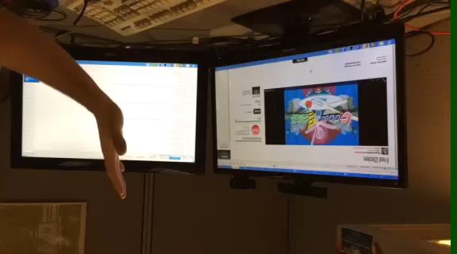
User Experience Design
Forgiveness (replace video with UXA fromn FN Help Panel)
Back
Notes:
First Iteration:
For the first prototype, a swipe was proposed for navigation. The idea of swipe is it to move your hand from one side to another, be it up, down, left or right. However, If you’ve seen user
Testing, it becomes apparent that swiping does not map well to gestures. When swiping on a touch screen, there is no need to be concerned with what the hand dopes after the swipe. Mapping swipe to gestures, we see that what the hand does after the gestures impact the experience. Swiping quickly, swiping slowly, swiping and holding the hand at the end, or swiping and then moving your hand back to the center of the screen are all corner cases to be concerned with.
Also not the lack of any feedback mechanic.

Slide 11
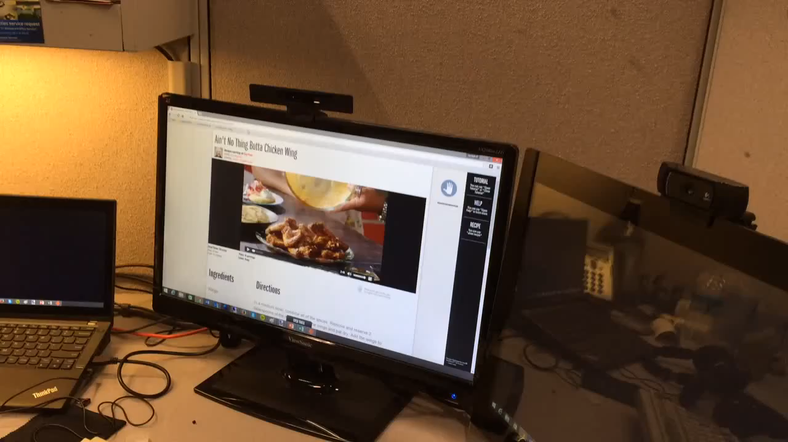
User Experience Design
Feedback mechanism One:
Back
Notes:
In this version we created a static feedback model seen on the top right of the screen. This indicates to the user their current action. As we watch the video I would like you to think about a few things:
Is the feedback responsive?
Does the feedback make sense?
Does the feedback detract from the experience?
Play Video
What are your thoughts / observations on the experience?
After competing user testing on this version we found that the feedback mechanism did not work well. Why? Well when users interact with web page content, the user wants to be looking at the content, not a visual box indicating they are interacting with content correctly. Also, the observe delay for scrolling when hovering and holding was perceived as latency.
//back up info
Feedback model One: issue with static feedback on the top right of the page was used to indicate to the user successful interactions. The problem… when interacting with web pages, the user is looking at the content, not a visual box indicating they are interacting with content. Let’s take a look at a video of the first feedback prototype.

Slide 12
Backup

